Slide 1
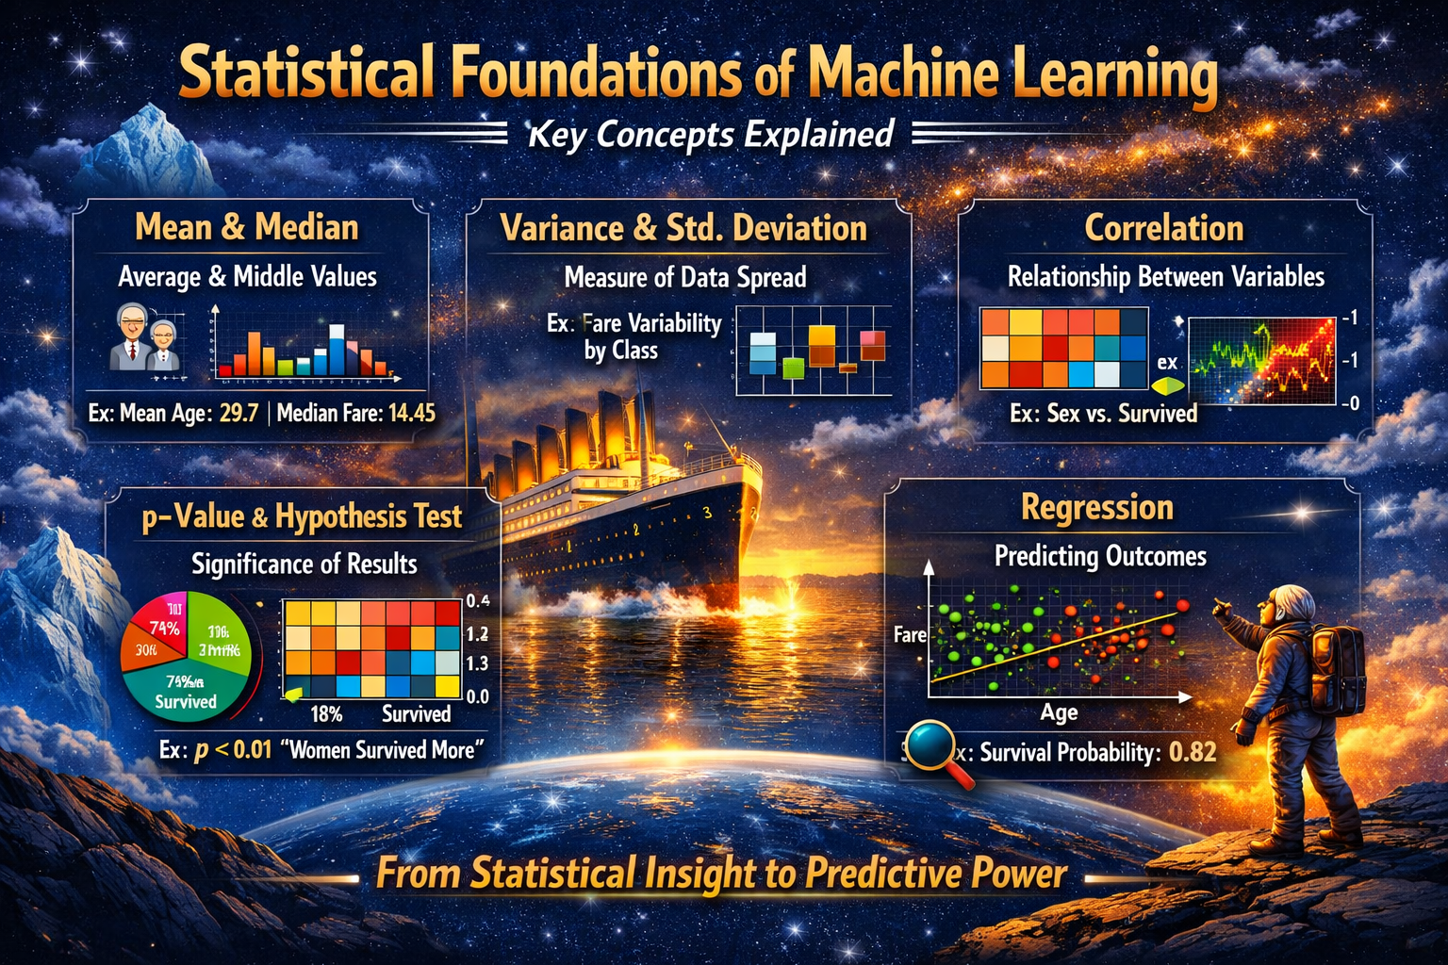
Statistics for Machine Learning
Dr Ashok Gopalakrishnan, Retired Scientist from NASA, Google Scholar, IBM WebSphere Champion

Slide 2
Statistics for Machine Learning
Why Statistics Matters in ML
Statistics is the foundation of machine learning — it helps us understand data patterns, variability, and relationships before we ever train a model.
Descriptive Statistics: Summarize data (mean, median, mode, variance).
Inferential Statistics: Draw conclusions from samples (hypothesis testing, confidence intervals).
Probability: Quantifies uncertainty — essential for predictive modeling.
Correlation & Regression: Measure relationships and predict outcomes.

Slide 3
Statistics for Machine Learning
Statistics forms the mathematical backbone of machine learning, enabling us to understand data, quantify uncertainty, and evaluate models effectively. Every ML workflow—from data preprocessing to prediction—relies on statistical principles.
Understanding Data: Before training models, descriptive statistics (mean, median, mode, variance, skewness, kurtosis) summarize data characteristics. This helps detect outliers, assess distribution shapes, and decide on preprocessing steps like normalization or transformation. For example, a highly skewed feature may require a log transform before regression. Engineering & Statistical measures like correlation and covariance reveal relationships between variables, guiding feature selection.
Probability & Uncertainty: Probability theory underpins ML models by quantifying uncertainty. Conditional probabilities are central to algorithms like Naive Bayes and logistic regression, where outputs are interpreted as likelihoods. Understanding probability distributions (Bernoulli, Gaussian, Poisson) is crucial for model assumptions, loss functions, and generative modeling.
Bayesian Methods: Bayesian statistics combine prior beliefs with observed data to update probabilities. This is widely used in Bayesian optimization, uncertainty quantification, and probabilistic programming.

Slide 4
Statistics for Machine Learning
import numpy as np
from sklearn.linear_model import LogisticRegression
from sklearn.metrics import precision_score, recall_score
# Sample binary classification data
X = np.array([[25, 50000], [40, 60000], [35, 80000], [50, 20000]])
y = np.array([0, 0, 1, 1])
model = LogisticRegression()
model.fit(X, y)
preds = model.predict(X)
print("Precision:", precision_score(y, preds))
print("Recall:", recall_score(y, preds))
Here, precision and recall are statistical measures derived from the Bernoulli distribution assumption of binary outcomes.

Slide 5

Statistics for Machine Learning
In essence, statistics in ML is not just about numbers—it’s about making data-driven, reliable, and explainable decisions. Without it, models risk being inaccurate, biased, or uninterpretable.
Use of Statistics in Machine Learning
Asking questions about the data
Cleaning and preprocessing the data
Selecting the right features
Model evaluation
Model prediction

Slide 6
Statistics for Machine Learning
In essence, statistics in ML is not just about numbers—it’s about making data-driven, reliable, and explainable decisions. Without it, models risk being inaccurate, biased, or uninterpretable.
Use of Statistics in Machine Learning
Population:
In statistics, the population comprises all observations (data points) about the subject under study.
An example of a population is studying the voters in an election. In the 2019 Lok Sabha elections, nearly 900 million voters were eligible to vote in 543 constituencies.
Sample:
In statistics, a sample is a subset of the population. It is a small portion of the total observed population.
An example of a sample is analyzing the first-time voters for an opinion poll.

Slide 7
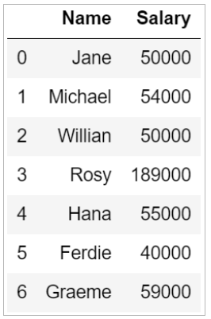
Statistics for Machine Learning
In essence, statistics in ML is not just about numbers—it’s about making data-driven, reliable, and explainable decisions. Without it, models risk being inaccurate, biased, or uninterpretable.
Consider the data frame below that has the names of seven employees and their salaries.

Slide 8
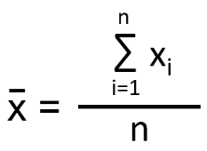
Statistics for Machine Learning
Measures of Central Tendency
Measures of central tendency are the measures that are used to describe the distribution of data using a single value. Mean, Median and Mode are the three measures of central tendency.
Mean:
The arithmetic mean is the average of all the data points.
If there are n number of observations and xi is the ith observation, then mean is

Slide 9
Statistics for Machine Learning
Median:
Median is the middle value that divides the data into two equal parts once it sorts the data in ascending order.
If the total number of data points (n) is odd, the median is the value at position (n+1)/2.
When the total number of observations (n) is even, the median is the average value of observations at n/2 and (n+2)/2 positions.
The median() function in Python can help you find the median value of a column. From the above data frame, you can find the median salary as:

Slide 10
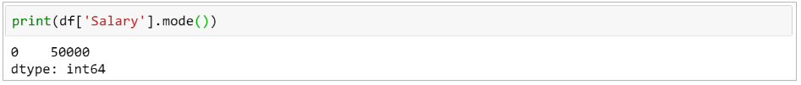
Statistics for Machine Learning
Mode:
The mode is the observation (value) that occurs most frequently in the data set. There can be over one mode in a dataset.
Given below are the heights of students (in cm) in a class:
155, 157, 160, 159, 162, 160, 161, 165, 160, 158
Mode = 160 cm.
The mode salary from the data frame can be calculated as:
Statistics is a core component of machine learning. It helps you draw meaningful conclusions by analyzing raw data

Slide 11
Statistics for Machine Learning
Applying Statistics to the Titanic Project
The sinking of the Titanic in 1912 was a tragic disaster that led to the loss of many lives.
The Titanic dataset provides information about the passengers onboard.
Our analysis aims to explore the factors influencing passenger survival.
By examining the data, we can gain insights into the demographics and circumstances that played a role in determining survival.
Our investigation aims to answer the following questions:
What were the key factors that influenced passenger survival on the Titanic?
How did variables such as age, gender, ticket class, and family size affect the chances of survival?
Can we identify significant predictors of survival based on the available data?
Are the differences in survival rates of different demographics really statistically significant to be able to make conclusions from it?

Slide 12
Statistics for Machine Learning
THE TITANIC PROBLEM
Concept | Example | Purpose
Descriptive Stats | Average age, fare, survival rate | Understand passenger demographics
Probability | Chance of survival given gender/class | Build intuition for model features
Correlation | Sex vs. Survived, Fare vs. Pclass | Identify influential variables
Hypothesis Testing | Did women have higher survival rates? | Validate assumptions statistically
Regression | Predict survival probability | Foundation for logistic regression model

Slide 13
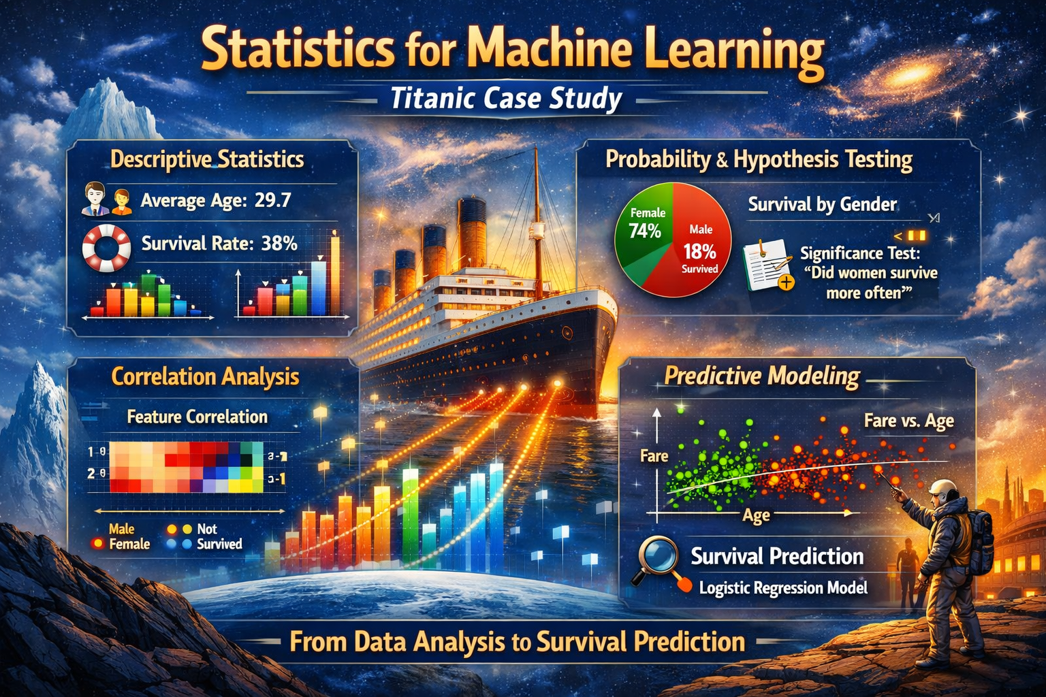
Statistics for Machine Learning
How Statistics Strengthens ML Understanding
Builds data intuition before modeling.
Helps in feature selection and data preprocessing.
Improves model interpretability — understanding why predictions occur.
Encourages critical thinking about bias, variance, and uncertainty.

Slide 14
Statistics for Machine Learning
This slide will visually summarize the five pillars of statistical reasoning that power ML models, using Titanic examples for context.
Concept | Definition | Titanic Example | Visual
Mean & Median | Central tendency measures showing average and middle values. | Mean age ≈ 29.7 years; median fare ≈ 14.45 ₹ | Bar chart of age distribution
Variance & Standard Deviation | Measure data spread and variability. | Fare variance shows economic diversity among passengers. | Boxplot of fare by class
Correlation | Quantifies relationships between variables. | Strong correlation between Sex and Survived. | Heatmap of feature correlations
p‑Value & Hypothesis Testing | Tests significance of observed differences. | p < 0.01 → women had higher survival rates. | Pie chart of survival by gender
Regression | Models relationships and predicts outcomes. | Logistic regression predicts survival probability. | Scatter plot of Fare vs. Age colored by survival

Slide 15
Statistics for Machine Learning
Mean & Median: Central tendency — e.g., Titanic mean age ≈ 29.7, median fare ≈ 14.45.
Variance & Std. Deviation: Spread of data — fare variability across classes.
Correlation: Relationships — strong link between Sex and Survived.
p‑Value & Hypothesis Test: Significance — p < 0.01 confirms women survived more often.
Regression: Predictive modeling — logistic regression estimates survival probability (e.g., 0.82).
To address these questions, please use statistical analysis to explore the relationships between various variables and the survival outcome. Specifically, you will examine the impact of demographic factors, socio-economic status, and other relevant variables on the likelihood of surviving the Titanic disaster. By applying statistical techniques, you aim to uncover patterns and insights that can enhance our understanding of passenger survival and provide valuable information for future similar scenarios.

Slide 16
Statistics for Machine Learning
Hands‑On Exercise Sheet: “Exploring Statistics in the Titanic Dataset”
Objective
Apply key statistical concepts — mean, variance, correlation, hypothesis testing, and regression — to understand survival patterns in the Titanic dataset.
Part 1: Descriptive Statistics
Load the dataset (titanic.csv).
Compute:
Mean and median of Age and Fare.
Survival rate (Survived column).
Plot a histogram of passenger ages.
python
import pandas as pd, matplotlib.pyplot as plt
df = pd.read_csv('titanic.csv')
print(df['Age'].mean(), df['Age'].median())
plt.hist(df['Age'], bins=20, color='skyblue')
plt.title('Age Distribution of Passengers')
plt.show()

Slide 17
Statistics for Machine Learning
Hands‑On Exercise Sheet: “Exploring Statistics in the Titanic Dataset”
Part 2: Variance & Correlation
Calculate variance and standard deviation of Fare.
Create a correlation heatmap for selected features (Age, Fare, Sex, Pclass, Survived).
python
import seaborn as sns
sns.heatmap(df[['Age','Fare','Pclass','Survived']].corr(), annot=True, cmap='coolwarm’)
Part 3: Hypothesis Testing
Test whether women had a higher survival rate than men.
python
from scipy.stats import ttest_ind
male = df[df['Sex']=='male']['Survived']
female = df[df['Sex']=='female']['Survived']
print(ttest_ind(female, male))
Interpret the p‑value: if p < 0.05, the difference is statistically significant.

Slide 18
Statistics for Machine Learning
Hands‑On Exercise Sheet: “Exploring Statistics in the Titanic Dataset”
Part 4: Regression
Build a simple logistic regression model to predict survival.
python
from sklearn.linear_model import LogisticRegression
from sklearn.preprocessing import LabelEncoder
X = df[['Age','Fare','Pclass']]
y = df['Survived']
X = X.fillna(X.mean())
model = LogisticRegression()
model.fit(X, y)
print(model.predict([[25, 50, 2]])) # Example passenger
Part 5: Reflection
Write a short paragraph (100–150 words) explaining:
Which statistical measure gave the most insight?
How did hypothesis testing validate your assumptions?
How does regression connect statistics to ML prediction?

Slide 19
Statistics for Machine Learning
Data
The Titanic dataset used in this investigation is a well-known dataset widely available in the data science community.
The data was originally collected from passenger records of the RMS Titanic, which sank on April 15, 1912.
The dataset includes information on various attributes of the passengers, such as age, sex, ticket class, fare, cabin, and survival status.
The dataset is publicly available and can be accessed from various sources, including online data repositories and libraries.
To replicate the data collection process, interested individuals can download the dataset from the source and access the raw data from kaggle.com by signing up.
The sampling method used to collect the data is not explicitly mentioned, as the dataset represents a comprehensive record of passengers aboard the Titanic.

Slide 20
Statistics for Machine Learning
In the Titanic dataset, there are several important variables that provide information about the passengers. Here are the key variables and their explanations:
Survived: This variable indicates whether a passenger survived or not. It is a binary variable, where 0 represents not survived and 1 represents survived.
Pclass: The passenger class represents the ticket class of the passenger. It is an ordinal variable with three levels: 1, 2 and 3. Where each number is denoting the class of the passenger.
Sex: This variable denotes the gender of the passenger. It is a categorical variable with two levels: Male and Female.
Age: The age variable represents the age of the passengers. It is a numeric variable measured in years. The youngest passenger on board was about 5 months old and the oldest passengers was 80 years old.
Parch and SibSp: They stand for “Number of Parents/Children Aboard” and “Number of Siblings/Spouses Aboard”. They are both discrete numeric variables.
Embarked: This variable represents the port of embarkation for each passenger. It is a categorical variable with three levels: C: Represents Cherbourg, Q: Represents Queenstown, S: Represents Southampton.

Slide 21
Statistics for Machine Learning
“Statistics as the Language of AI”
Descriptive statistics help machines see data.
Inferential statistics help them reason from samples.
Probability theory helps them decide under uncertainty. It is said that : “Every ML algorithm is a statistical hypothesis — a model that learns patterns and tests them against reality.”
Bridge to Machine Learning
Statistical Concept | ML Equivalent | Example
Mean & Variance | Feature scaling, normalization | Standardizing Titanic features
Correlation | Feature selection | Removing redundant predictors
Probability | Naïve Bayes, Bayesian inference | Predicting survival likelihood
Regression | Linear/Logistic models | Survival prediction
Hypothesis Testing | Model validation | Comparing model accuracy across samples

Slide 22
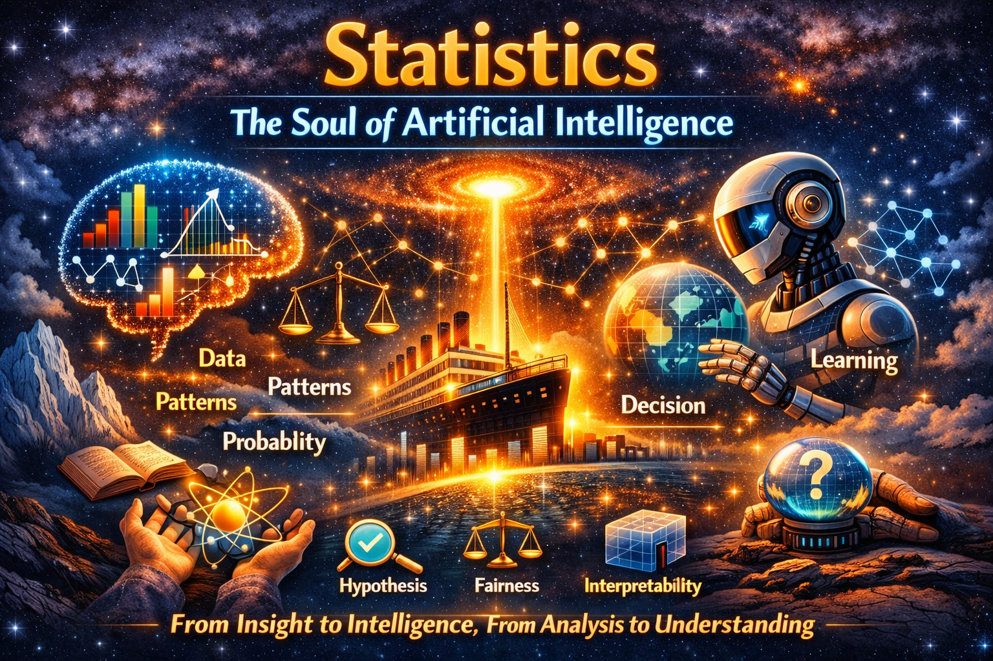
Statistics for Machine Learning
“As we sail from the Titanic dataset to the galaxies of AI, remember — statistics is not just a tool, it is the soul that gives machine learning its power to reason, decide, and inspire.”

Slide 23
Statistics for Machine Learning
Reflection Activity: “From Numbers to Wisdom”
Thought Question — The Bridge
How does statistical reasoning transform raw data into intelligent decisions in AI? → Encourage students to connect descriptive statistics (seeing patterns) with inferential reasoning (making predictions).
Thought Question — The Balance
Why is fairness a statistical concept as much as an ethical one? → Discuss bias, variance, and how sampling errors can lead to unfair AI outcomes.
Thought Question — The Future
If AI learns from data, who ensures it learns truthfully? → Inspire reflection on interpretability, transparency, and responsibility in AI systems.

Slide 24
Statistics for Machine Learning
Questions for today, the 18 June 2026
What have you learnt from the Titanic Disaster?
Distractions are dangerous, elaborate
Stakeholders should be kept informed, yes/no
Traceability is essential, what do you think?
Documentation may have lasting benefits, true or false and why
Kindly answer the above and submit the same to my mail id on or before 20 June 2026

Slide 25
Statistics for Machine Learning
CONCLUSION
As we reach the end of today’s journey, let us remember that statistics is not merely a collection of formulas or graphs — it is the heartbeat of artificial intelligence. Every algorithm we design, every prediction we make, and every insight we uncover begins with the language of numbers. Statistics gives AI its ability to perceive patterns, quantify uncertainty, and transform data into decisions. It is the invisible compass guiding machines toward understanding the world as we do — through evidence, probability, and reason.
In the Titanic case study, we saw how simple statistical measures — mean, variance, correlation, and hypothesis testing — evolve into the foundation of machine learning models. What began as descriptive summaries of survival rates became predictive insights into human behavior under uncertainty. This transformation mirrors the essence of AI itself: learning from the past to anticipate the future.

Slide 26
Statistics for Machine Learning
Beyond computation, statistics teaches us humility — that every dataset carries bias, every model carries assumptions, and every prediction carries uncertainty. It reminds us that intelligence, whether human or artificial, must be tempered with fairness, transparency, and interpretability. In this sense, statistics is not just the science behind AI; it is its soul — ensuring that our pursuit of knowledge remains anchored in truth and ethics.
So, as you step forward into the world of machine learning, remember: numbers may power the algorithms, but understanding powers the mind. Statistics is where insight becomes intelligence — and where analysis transforms into wisdom.

Slide 27
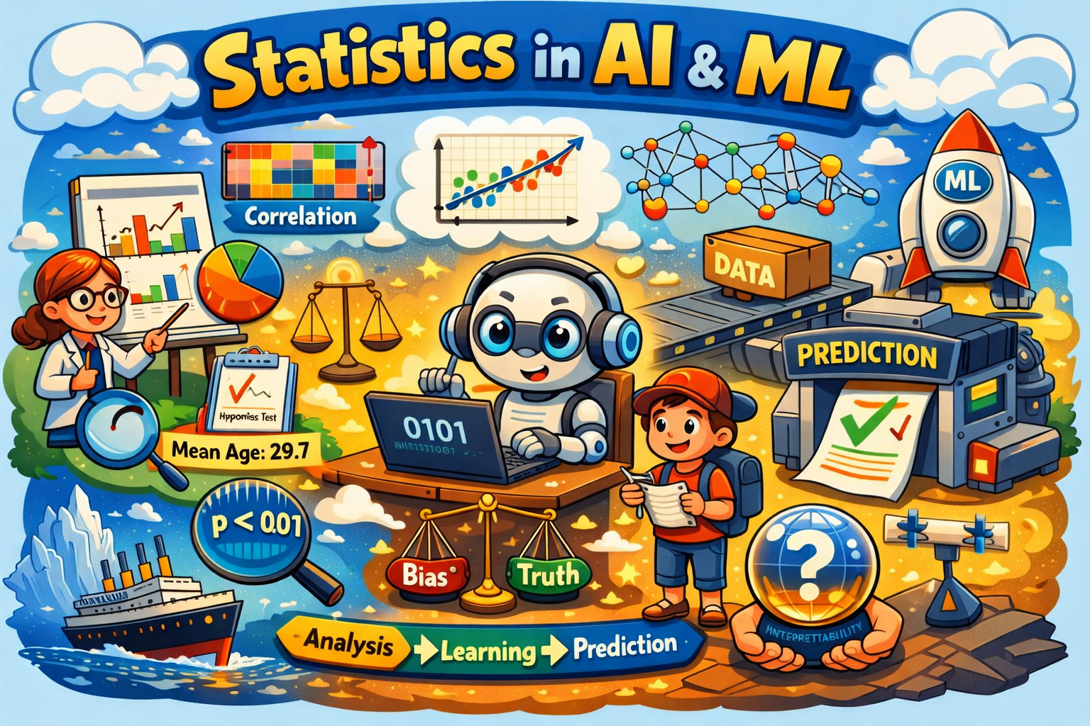
Statistics for Machine Learning

Slide 28
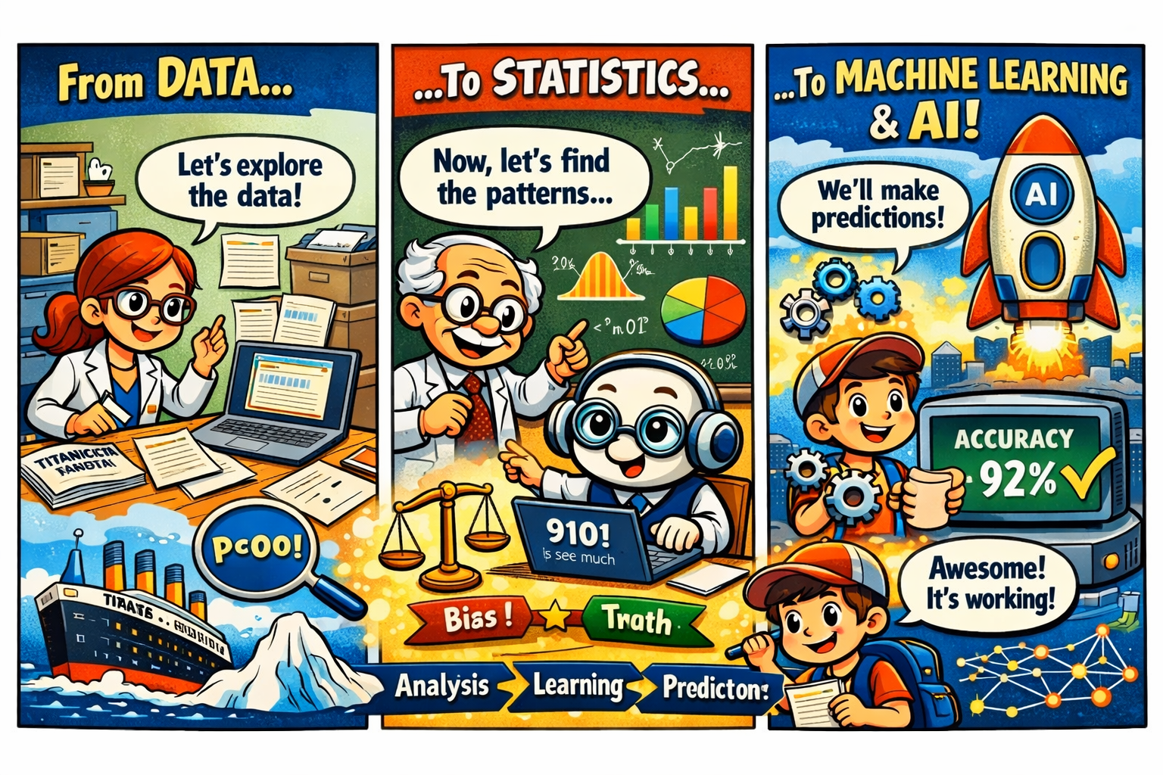
Statistics for Machine Learning
“From the Titanic dataset to the rocket of AI, statistics is the engine that transforms curiosity into discovery.”

Slide 29
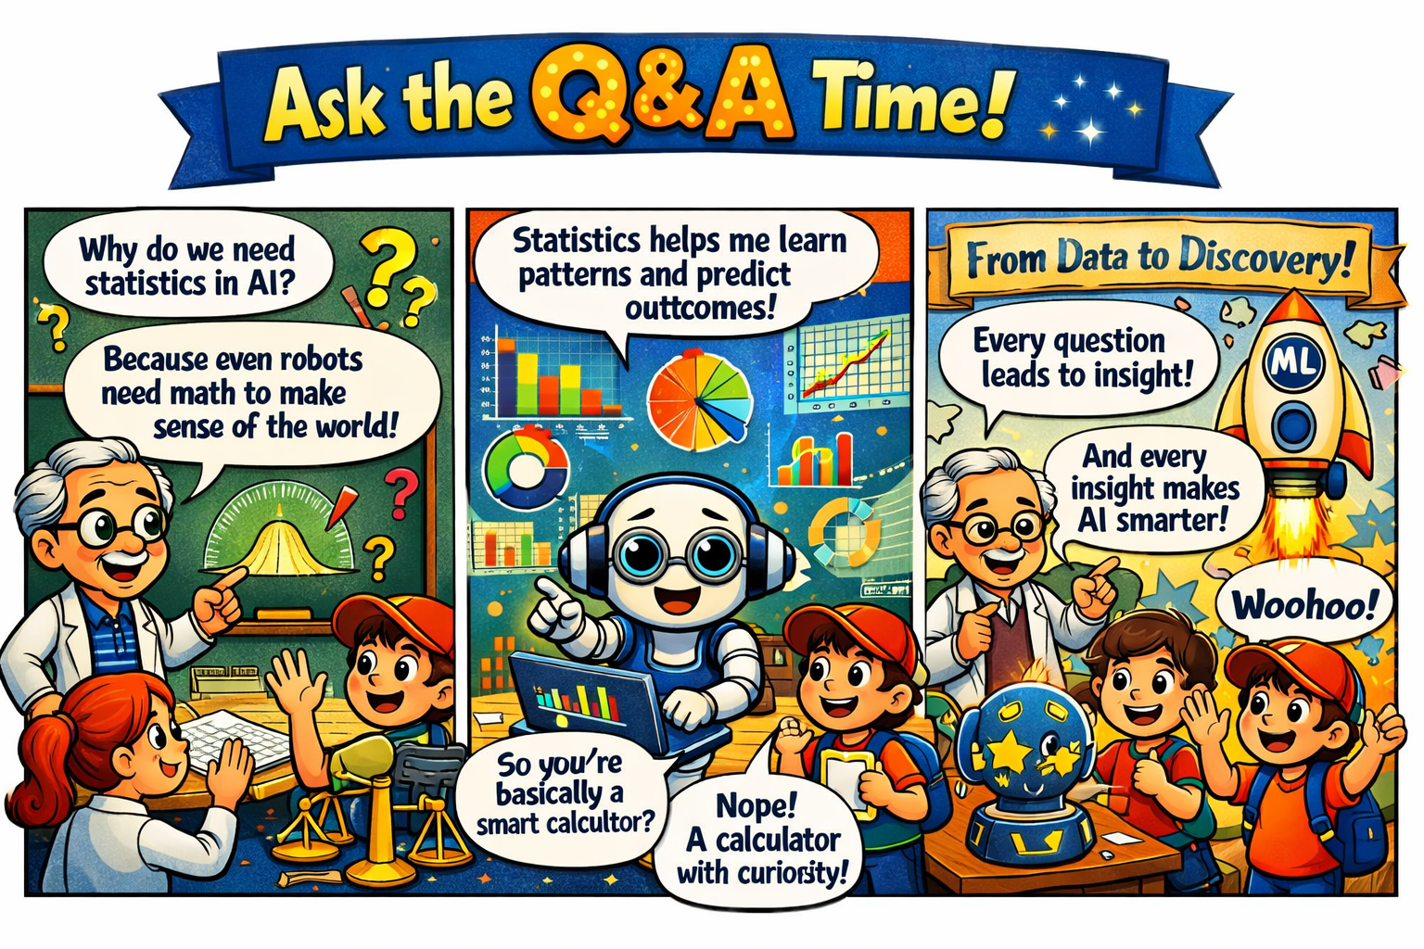
Statistics for Machine Learning

